Slide 1
ENSE 470, Milestone 4
Group Eh?
Nickolas Schmidt, Quinn Bast, Abdulaziz Alghamdi,
March 1st 2018

Slide 2
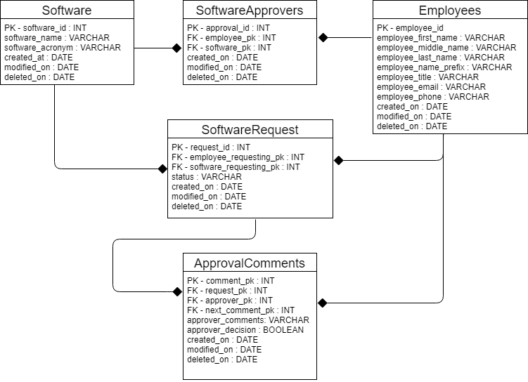
Database Snapshot

Slide 3
Database Information
Database:
MySQL database using PhpMyAdmin interface
3rd Normal Form to allow for future adaptations and changes
Employee table slightly complex – first, middle, last and prefix name fields
Data Cleansing:
Manually typing INSERTs are tedious. Thus:
Notepad++ find and replace with Regexs to easily create INSERT statements.
Linked software to approver with PHP instead of manually typing the INSERT.
Problems:
Assumed that the myeHealth software is different in each region

Slide 4
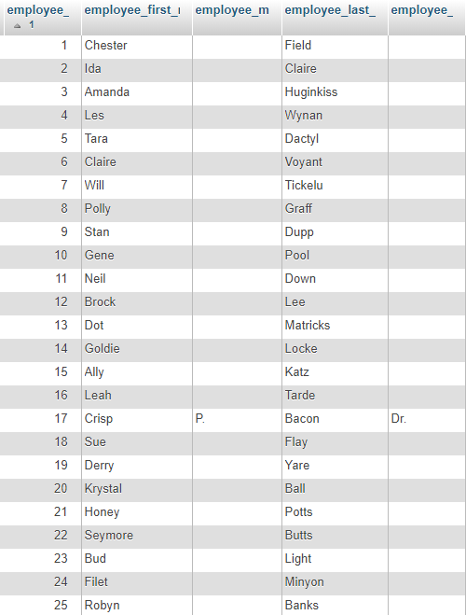
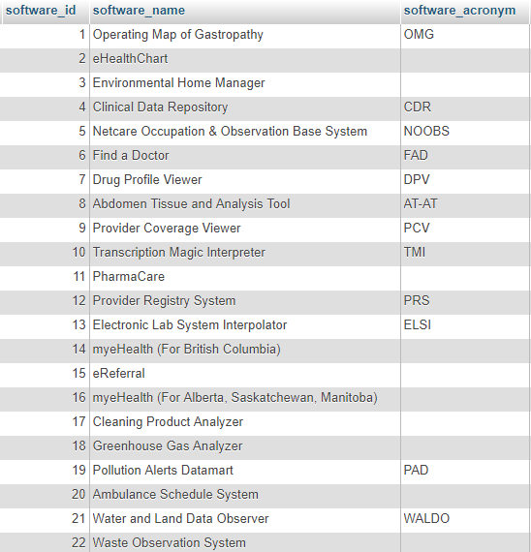
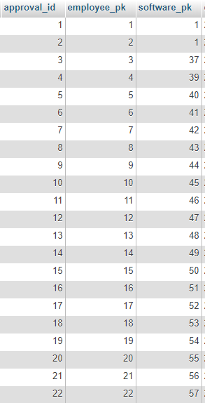
Employee Table
Software Table
Software Approvers Table

Slide 5
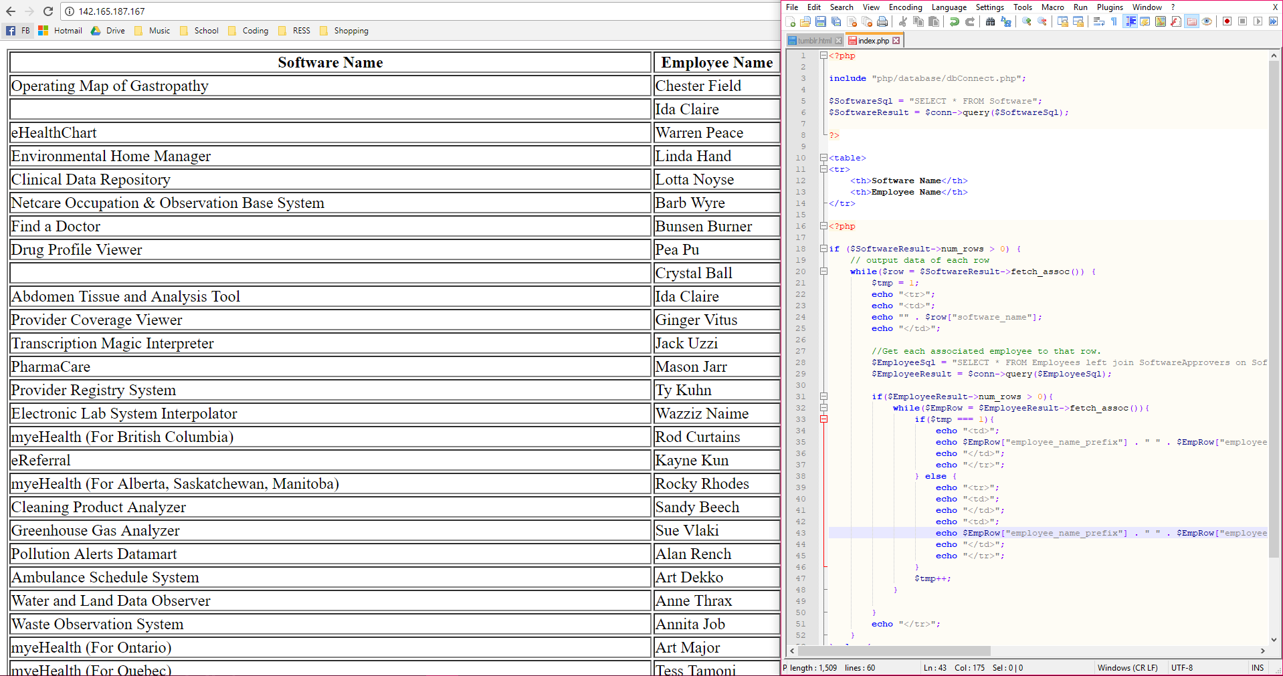
With some Php Magic: http://142.165.187.167/

Slide 6
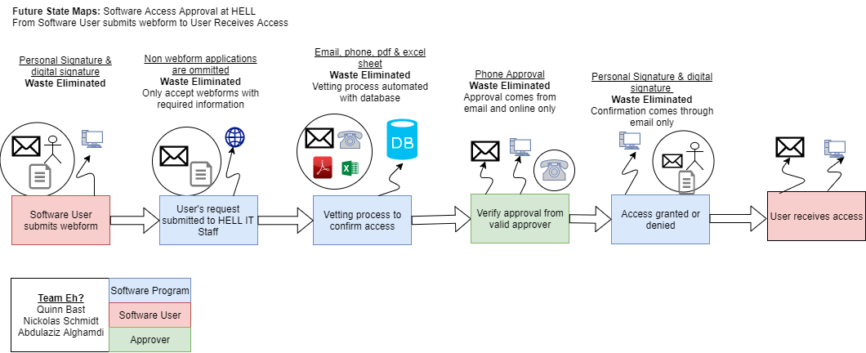
Recall, future state VSM

Slide 7
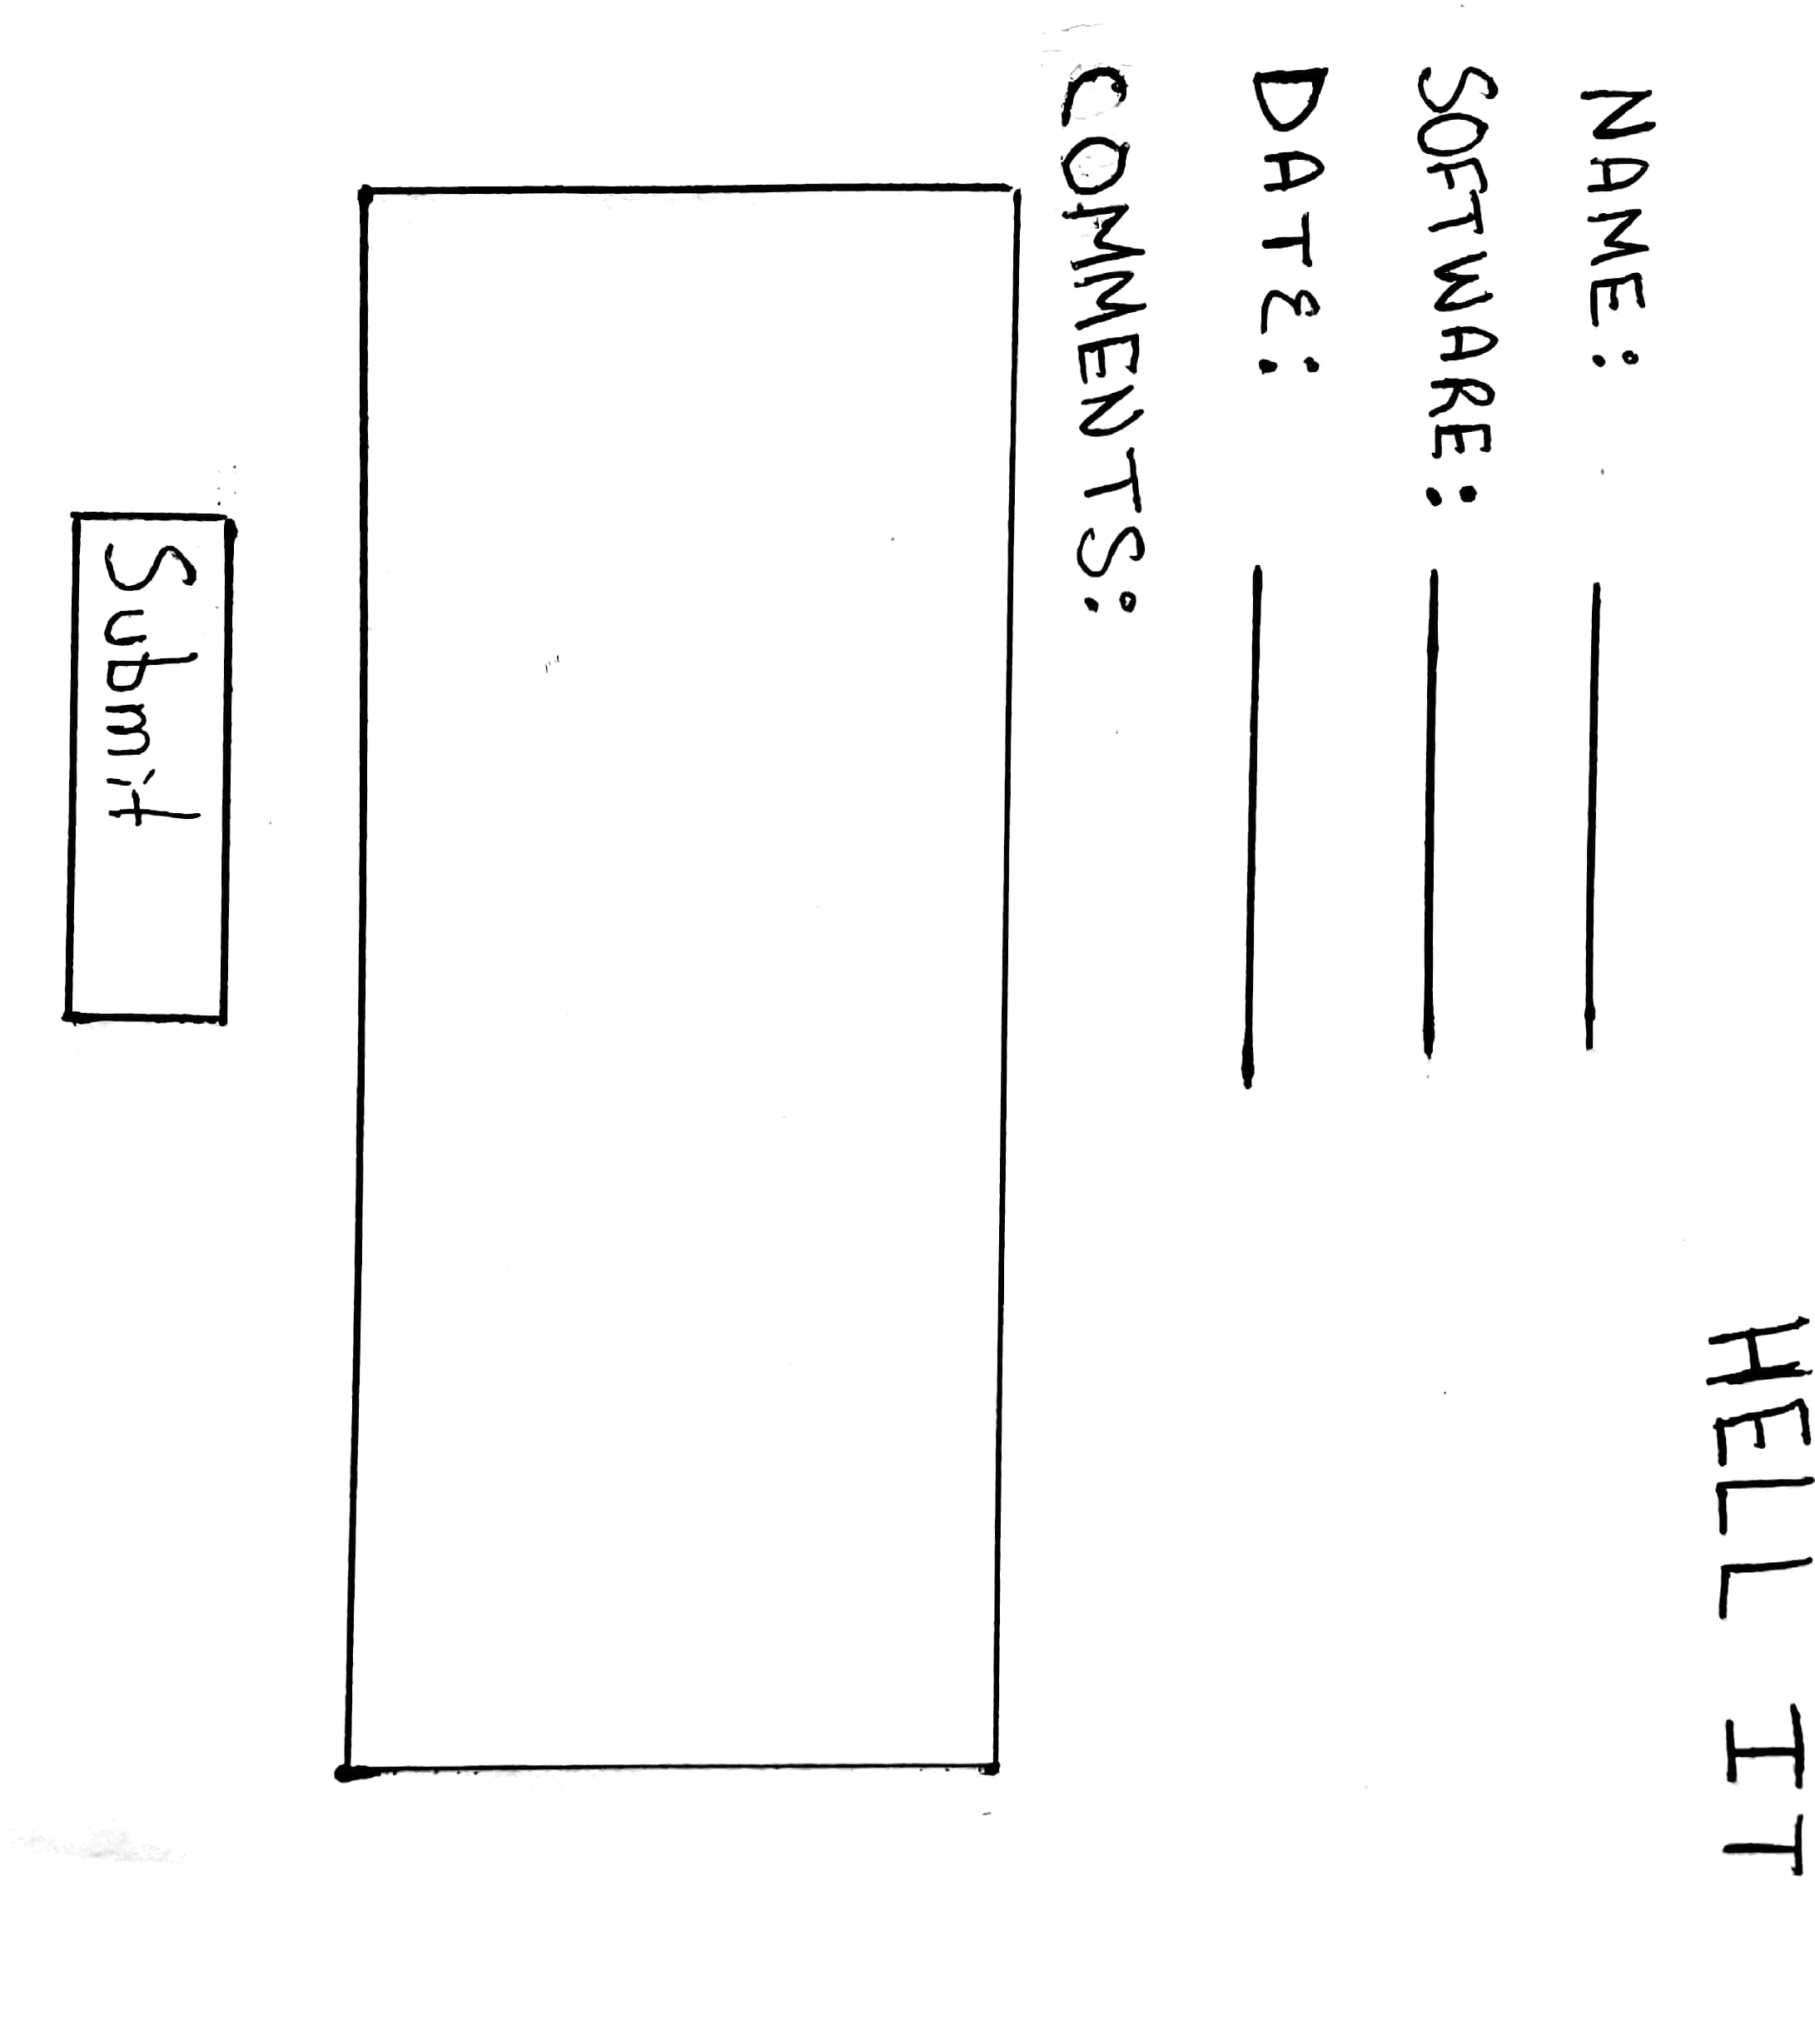
Low Fidelity Prototypes

Slide 8
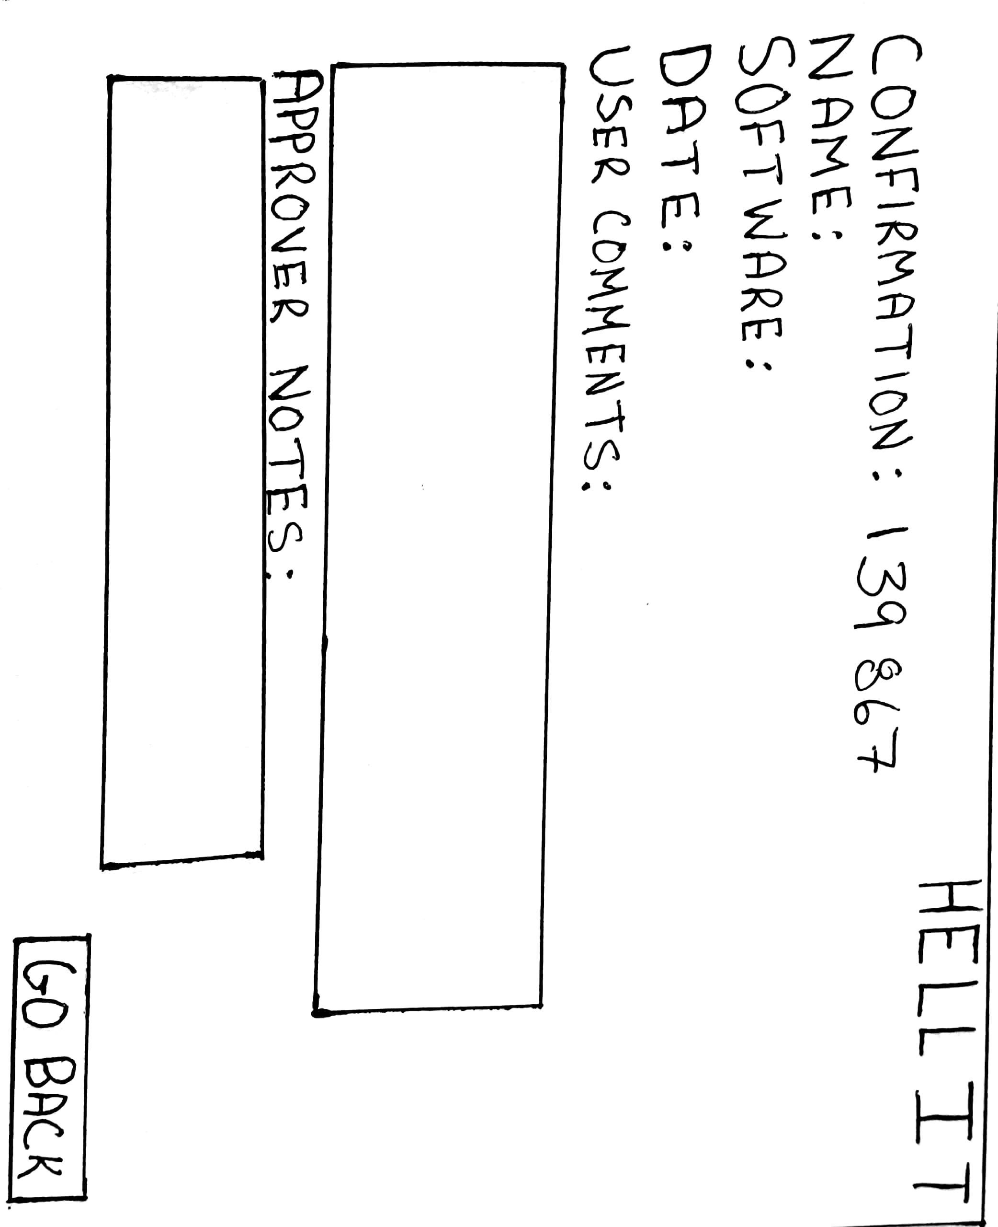

Slide 9
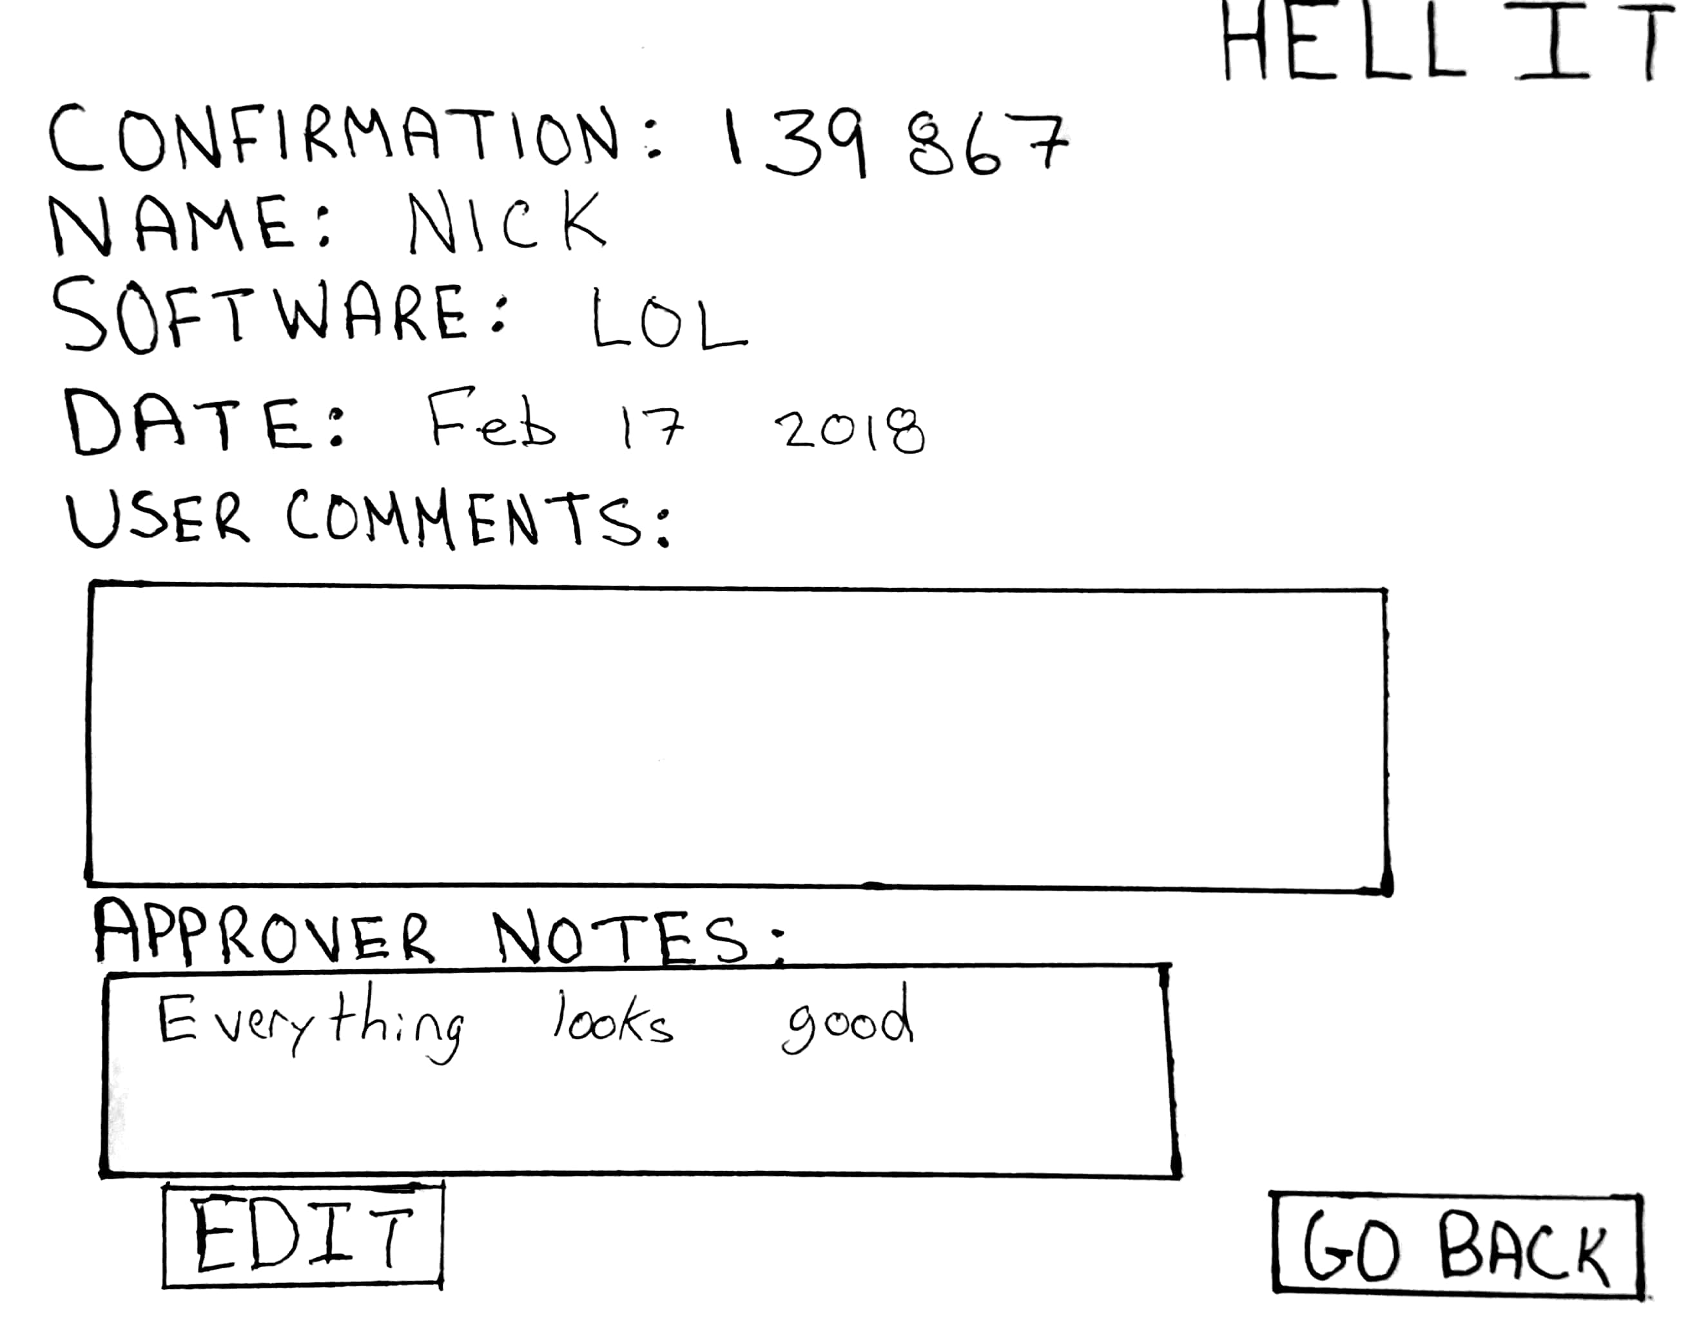

Slide 10
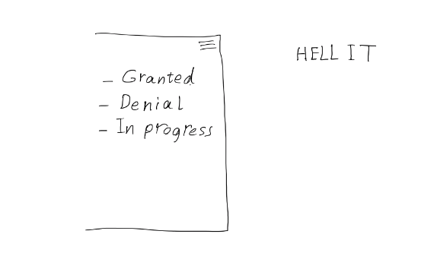

Slide 11
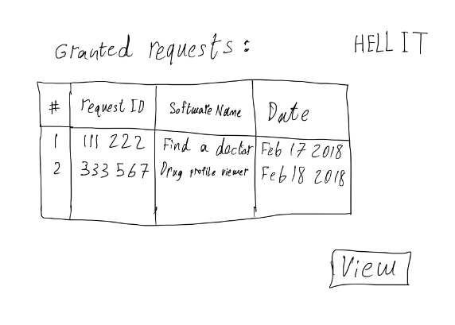

Slide 12
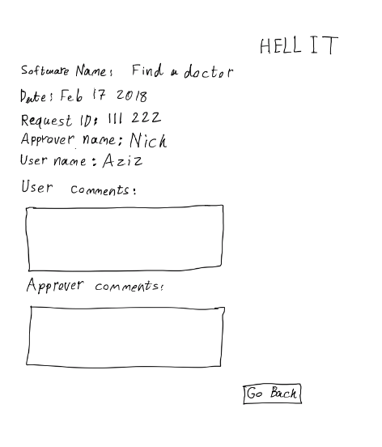

Slide 13
Group reflection
How did you feel about this milestone? What did you like about it? What did you dislike?
This milestone was fun to do and allowed us to further our vision for the end project
What did you learn about yourself as you collaborated and worked through this milestone?
We learned that Quinn is really good with databases!
How will you use what you have learned going forward?
The database for sure, and the Lo-Fi prototypes help us further our programs design
What “stuff & things” related to this milestone would you want help with?
I believe this milestone was fair and easy enough to do although I can't speak for Quinn and the database

